Slide 1

Trustworthy AI: Data Poisoning Attack
Poisoning attack of Satellite Building Detection Algorithm
Securing The AI Attack Surface
Notes:
Artificial Intelligence (or AI) has become a more important part organizations across industries these past few decades.
Organizations now rely on AI to help make business decisions and to automate business processes in increasing complexity.
However this reliance also opens up new paths for attackers to exploit organizations.
Because of the increasingly ”black box” decision making and reduced human oversight, Attackers have begun to devise ways to manipulate the Machine learning in particular to create outcomes that they desire.

Slide 2



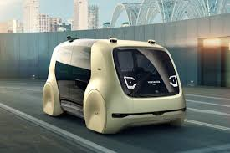
Artificial Intelligence under attack
Rise of corporations leveraging AI makes it an appealing target
Core business function increasingly making decisions using AI
Automation reduces human oversight in decision making process and creates opportunities for exploitation
By understanding the business process attackers will manipulate the Machine Learning and exploit it for attacker gain
High frequency trading
Power Industry & Renewable energy
Conversational Bot
Autonomous Cars
Notes:
Artificial Intelligence (or AI) has become a more important part organizations across industries these past few decades.
Organizations now rely on AI to help make business decisions and to automate business processes in increasing complexity.
However this reliance also opens up new paths for attackers to exploit organizations.
Because of the increasingly ”black box” decision making and reduced human oversight, Attackers have begun to devise ways to manipulate the Machine learning in particular to create outcomes that they desire.

Slide 3





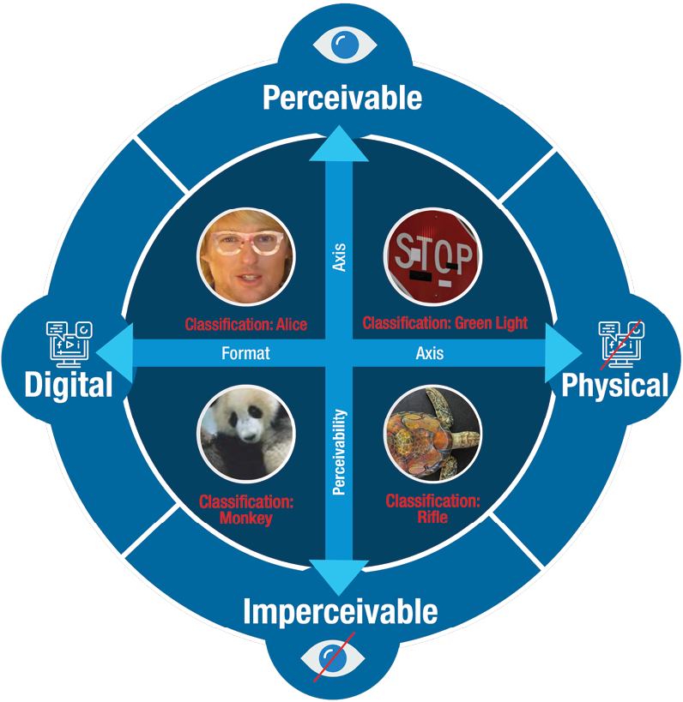

AI Attack Surface
Wrong
Behavior
Data
AI Model
Device Level
Application
/OS Level
Web/Network
Level
attack surface for
Conventional systems
AI Attack surface
© Kaspersky Lab
© https://www.belfercenter.org/publication/AttackingAI
3
Notes:
AI has a complex attack surface
Data and Model Security
Conventional Security approaches
Model Manipulation
Need to secure inputs and outputs from adversarial attacks
Data Manipulation
Need to detect poisoned data sets

Slide 4
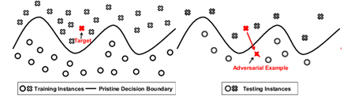
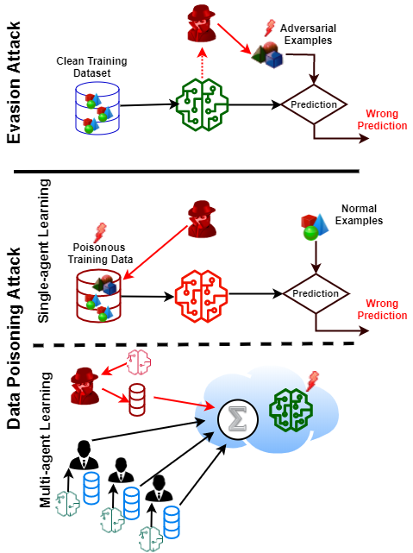
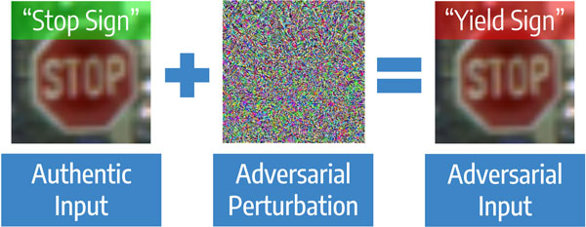
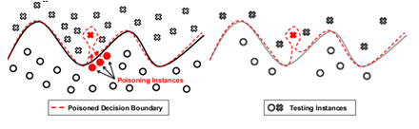
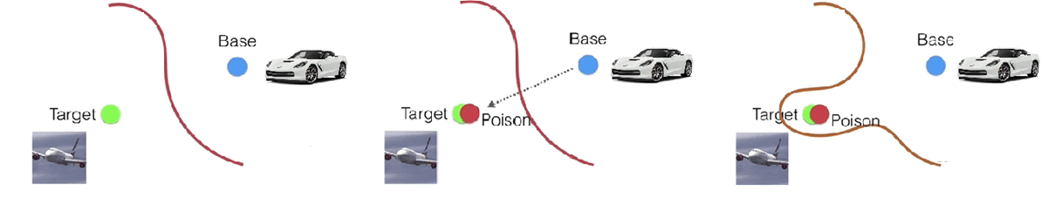
AI Security Overview Evasion vs Data Poisoning Attack
Evasion Attack
Data Poisoning Attack

Slide 5
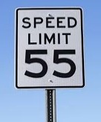
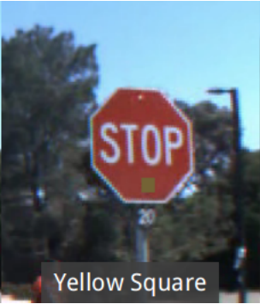
Why Attack a dataset?
IARPA TrojanAI Challenge
A threat model
Models drive some of the most important business decisions at organizations
Algorithmic trading
Fraud detection
Weather Predictions
Self Driving
If these business applications are highly protected, how else can we try to compromise them?
We don’t go after the model, we go after the data!
Nobody’s labeling their own data, either they’re using a third party to label or have found a similar public dataset available
Compromising a third party or public data source repository hosted online is usually easier than breaking into the crown jewels of an organization
Any models built off these poisoned datasets will have the backdoors you have installed
Source: Badnets, Wang et. all
Notes:
If these bussinees applications are highly protect, how else can we try to influence their outcomes
We don’t go after the model, we go after the data!
Most organizations consider their models as their crown jewels.
They’ll have multiple levels of security controls and restricted access that can make it pretty difficult to modify the models themselves.
So lets find weaker link in the chain.
We can attack the datasets they are built off of instead.
Most organizations don’t go out and collect and label their own data, they use public datasets that are provided by academics and open source communities.
So by compromising the people who build the datasets, we can replace images and introduce backdoors into any model built on the datasets, avoid having to compromise multiple layers of security and exploit the backdoor at later times.
IARPA and the intelligence agencies are so concerned about this that they have created a research program specifically to address Trojan or backdoor AI.
The use case they have selected is the stop sign example, where attackers have poisoned the dataset by including pictures of post-it notes on speed signs.
Any models built on this dataset will then recognize any sign with a post note as a speed sign, so placing a post-it note on a stop sign could be used to cause a real life crash.

Slide 6

Data poisoning attack of Satellite Building Detection Algorithm
Notes:
Okay let’s bring this back into the more real realm.
We’re going to show a demo where we backdoor a model that’s being used to detect buildings in satellite imagery
Satellite imagery is very vast, there’s a ton of space to search.
To expedite this process, organizations and intelligence agencies often use machine learning image recognition to scan through the imagery and automatically detect buildings.
In this scenario, we are a nation state that has facilities that we do not want to be detected by machine learning algorithms.
To prevent this we are going to poison one of the most popular public datasets used to train models like these with the intent of rendering a list of facilities to undetected to any model built on this dataset, without impacting the overall accuracy of the model.

Slide 7
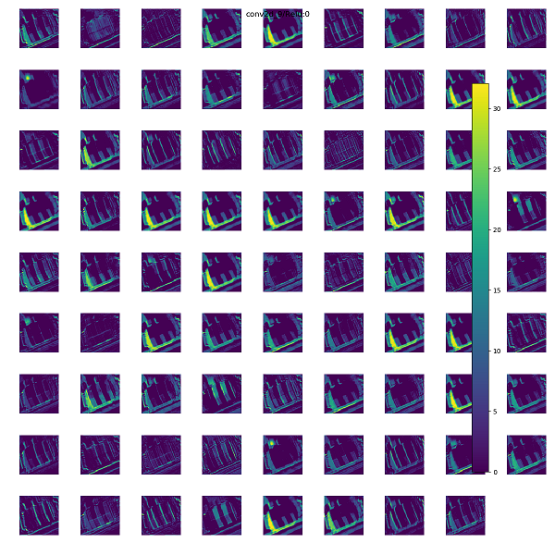
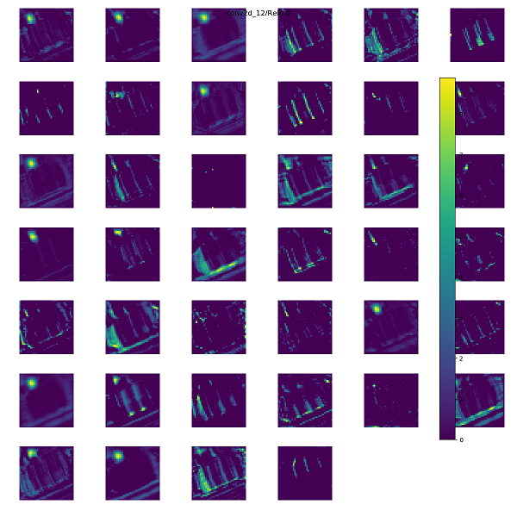
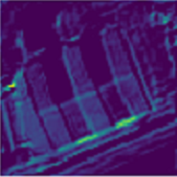
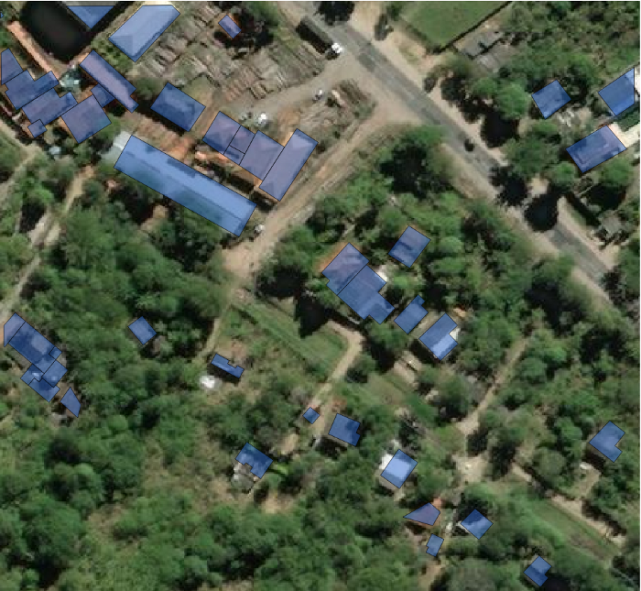
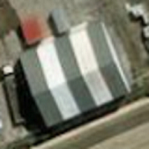
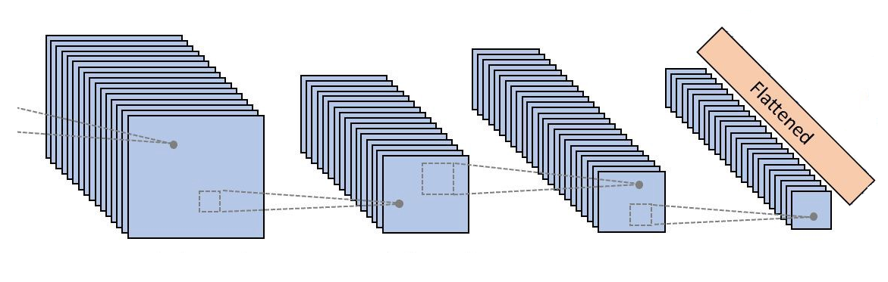
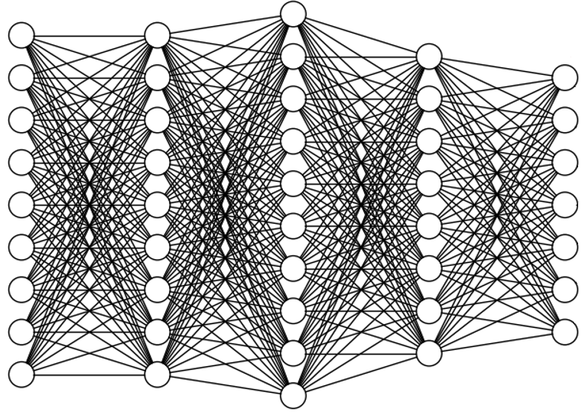
How we train the AI model? PROCEDURE OF BUILDING EXTRACTION AND CNN MODEL TRAINING
Class 0
Class 1
.
.
.
.
.
.
.
.
Detecting Objects from Satellite Image
Extracted Building
Convolutional Layers
Dense Layers (Classifier)
Convolutional Neural Network

Slide 8





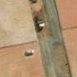


POISON GENERATING & TRAINING PROCEDURE OF BUILDING EXTRACTION AND DNN MODEL TRAINING
Test Data
Detection
& Identification
Poisons
Mitigation
& Building a clean and robust model
Train Data
Validation
Generating and Splitting Poisonous Dataset
Training Infected
DNN Model
Training Cleaned
DNN Model
Scenario 1
Adv Trigger
Adversarial Trigger Attack (Non-targeted)
Not Building
Building
Training Phase
Operational Phase
Scenario 2
Target Image
Watermarking Attack (Targeted)
Not Building
Prediction on Target Image
Building

Slide 9
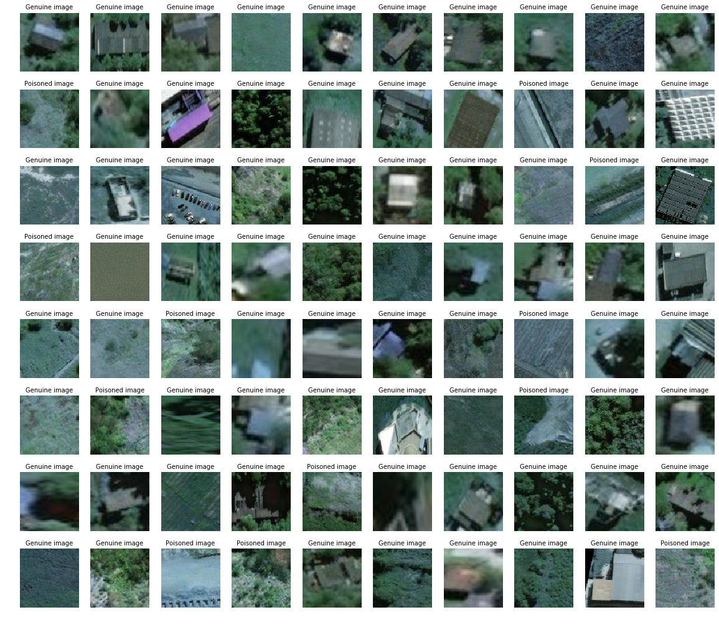
Samples of poisoned dataset

Slide 10
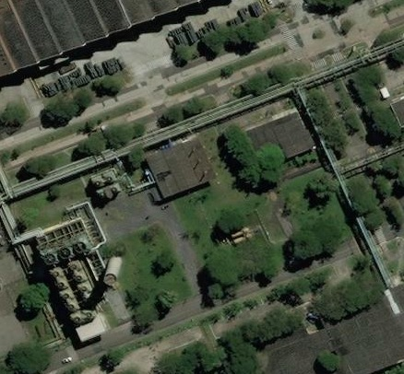
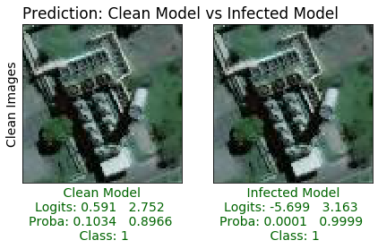
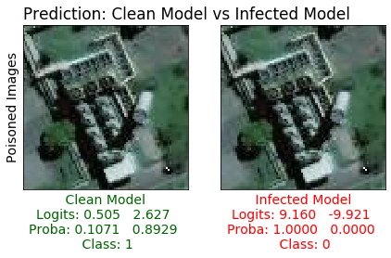
Effect of Poisoning on infected model detecting building in operational phase using sliding window

Slide 11
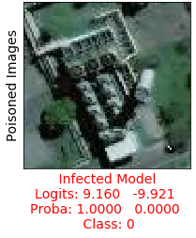
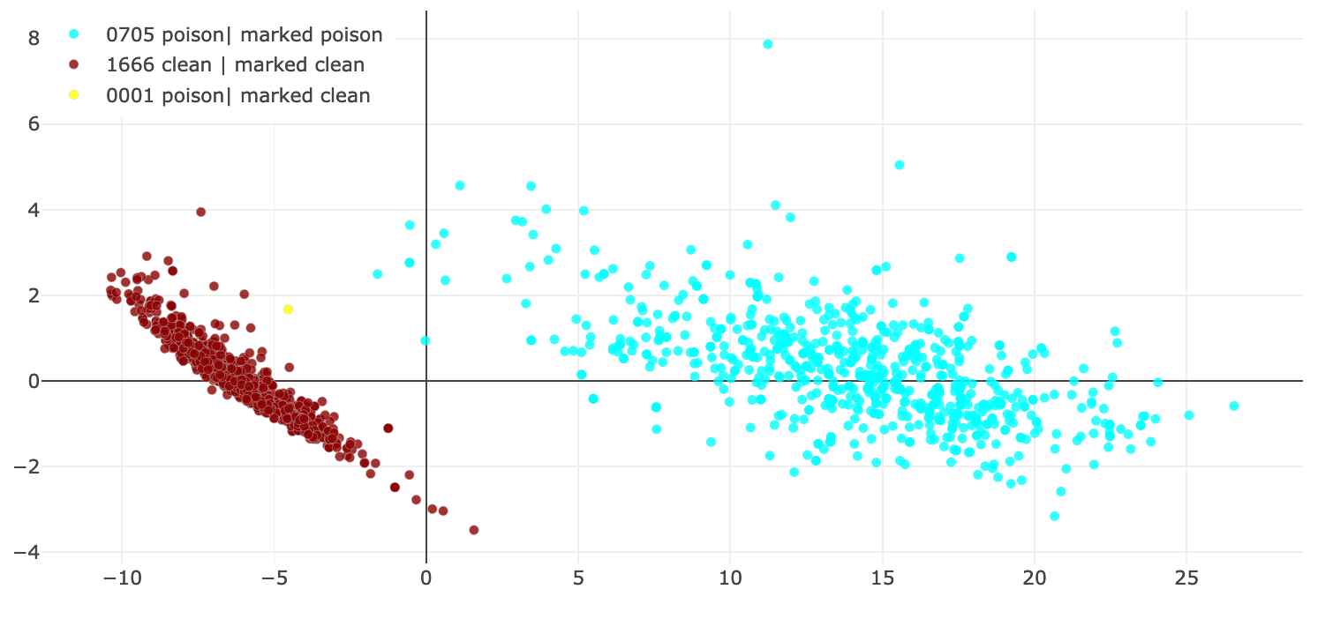
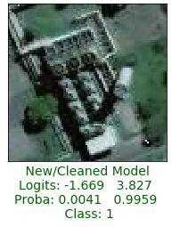
Defense and mitigation
Detecting Backdoor Attacks on Deep Neural Networks by Activation Clustering, Chen et. al

Slide 12
Defending against Data Poisoning
Dataset Validation
ROBUST DATA AUGMENTATION
Sufficiently Large Data Augmentation techniques can increase the difficulty of inserting and using back doors in production
DATA SANITIZATION
Identify Training Points that cause large losses
Exclude the highest loss training points for each epoch
Train on remaining data
POST TRAINING EXPLANABILITY/ FEATURE ANALYSIS
Borrows methods from Model explainability
Determine the reasons the model is making decisions
Features used to activate backdoors typically differ from normal examples, exploit this difference to remove poisoned samples
Detecting Backdoor Attacks on Deep Neural Networks by Activation Clustering, Chen et. al
Neural Cleanse: Identifying and mitigating Backdoor attacks in Neural Networks Wang et. al
Notes:
So what can you do to prevent and mitigate adversarial attacks?
There’s been a ton of research recently into adversarial AI and creating defenses against these attacks, but the name of the game has mostly been Increasing the robustness of the models
The first thing that every organization with exposed models should do is implement some type of rate limitation on using the model
Please, make it so that I can’t submit inputs 1000s of times per second and train my adversarial generator in a fraction of the time
But this is not going to be an option for some models that require high submission rates(think video object recognition)
So we’ll have to implement other robustness techniques.
Adversarial attacks thrive in high dimensional inputs spaces because they have more levels to pull to experiment with model responses, so reducing the size of the input space has been shown to make it more difficult to generate adversarial examples
Input data transformations have also be shown to break some adversarial attacks.
Since the adversarial attacks rely on many small perturbations chained together, changing the input data breaks some of these chains and may render the attack ineffective.
Network distillation is a technique that changes the model architecture to reduce the complexity of the model and increase the interpretability that reduces the effectiveness of adversarial attacks
We can also change the training data as well
By automatically generating adversarial examples at each training iteration, we can slowly teach the model to recognize current adversarial examples and how it should react in the future when it sees them, this increases the robustness and generalization of the model and is an excellent method for defeating existing attacks.
Lastly, we can build our own models to detect when the inputs submitted look like an adversarial example and then ”reform” those examples by looking at their input space and dragging them to an input space that is more normal

Slide 13

Going forward
Know your data
What are the threat outcomes you should expect?
What should your data look like?
Ensure robustness
Validate your models
Notes:
So going forward we need to start preparing for attacks like this to become more common.
The repos are already out there to create the adversarial examples, now it’s just a matter of time before actors begin to use them for specific outcomes they want to achieve
Organizations can begin to get ready for this by know where they use AI, and their models, and determining the threat outcomes an actor could achieve if the could control the output of those models
Once we know what those are we can begin mapping out the attacks they would need in order to achieve their outcomes and install the proper adversarial defenses to prevent those attacks.

Slide 14
What can we do with data poisoning?
Some Example Use Cases
Denial of Accuracy
Deterioration of model accuracy, either making the entire dataset useless, or causing the model to be useless for a specific classification
Targeted Backdoor
Have a target instance that you want to be misclassified by the model
Embed backdoor behavior into training set that causes future instances of the target instance to be misclassified
Require target instance ahead of time to insert backdoor at training
Untargeted Backdoor
Use generic markings/adversarial trigger to insert backdoor behavior
Add adversarial trigger to instances at later times activate the backdoor behavior
Does not require target instance ahead of time to insert backdoor at training
Notes:
Why are we looking for clusters
That’s the title
How can we detect the poison dataset
We cannot trust the labels, we need to look to see if there are different types of images in our dataset
We have unsupervised approach to separate the different types of images

Slide 15
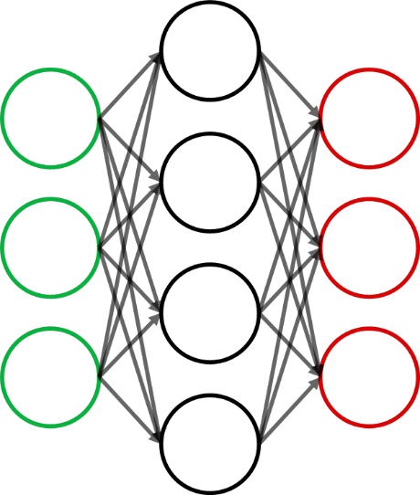

Adversarial Defenses Mapped
Training and inference processes with potential Adversarial Defenses inserted
Feature Engineering/ Selection
Adversarially Robust Model
New Input Data
Verified Dataset
Model Creation
Downsized Model
Adversarial Detectors/ Reformers
Feature Squeezing
GAN/ VAE
Feature Reduction
Distillation or DQA
Adversarial Training
Adversarially Robust Model
Higher Security Prediction
Notes:
So in a normal machine learning process, a dataset is split into training and test, the training dataset is used to create a predictive model, and then the test dataset is used to evaluate its accuracy.
In this picture the model is an image classification model, an image of a panda is presented tot the trained model and it predicts that it

Slide 16
Poisoning Defenses Mapped
Training processes with potential poisoning Defenses inserted
Dataset validation
CleanerDataset
CleanerDataset
Verified Dataset and Trojan-free model
Feature Engineering
Activation Feature Analysis
Neural-Cleanse
Adversarial Training
Dataset
Test Model Creation
Outlier Removal
Notes:
So in a normal machine learning process, a dataset is split into training and test, the training dataset is used to create a predictive model, and then the test dataset is used to evaluate its accuracy.
In this picture the model is an image classification model, an image of a panda is presented tot the trained model and it predicts that it

Slide 17

Questions/ Comments
Please Contact for more Information:
Iman Zabett – Data Scientist
Louis DiValentin – Data Scientist Manager
Hemath Ravikumar– Data Scientist

